Slide 1

Enterprise Web Software Development
GROUP 4 PRESENTATION

Slide 2
Enterprise Web Software Development
INTRODUCTION
QUICK OVERVIEW
FAQ
DEMO

Slide 3
INTRODUCTION
Quick introduction about the group, and the product

Slide 4

Group Introduction
Group 4 – 6 members
Le Hong Phong.
Nguyen Quang Vinh.
Dao Van Hieu.
Dinh Thi Lan Hue.
Lu Thua Thong.
Le Thanh Trung.

Slide 5
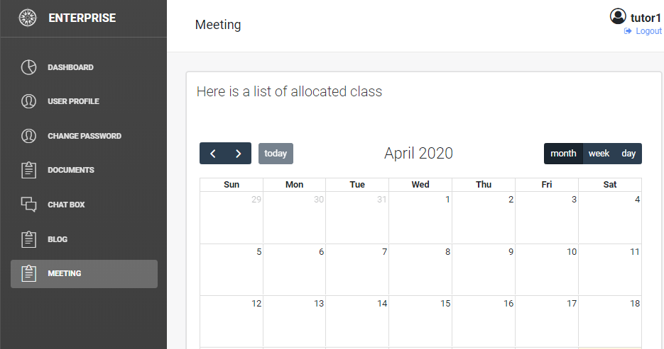
Product Introduction
Name: Enterprise Web Software Development.
Development time: 8 weeks.
Purpose: To build a web-based secure role-based system for eTutoring in a large university .
Goal: Can adopted agile scrum working practices and build a run-able web application.

Slide 6
Used Tools, Languages and Technologies
Spring Boot Server.
React.
Redux.
STOMP.
Java.
HTML.
JavaScript.
Eclipse, Chrome, Microsoft Edge, Google Doc, Google Sheet …

Slide 7
Quick overview
Product overview

Slide 8
Database

Slide 9
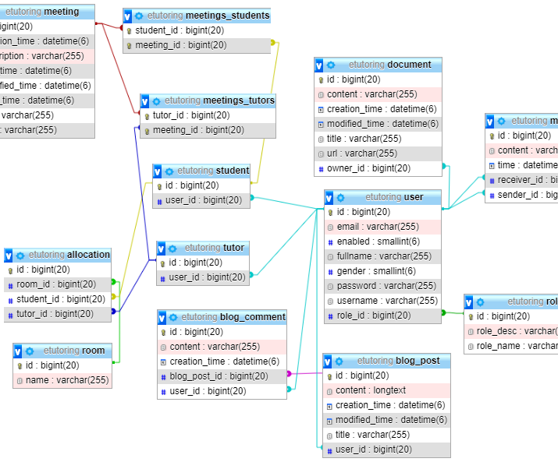
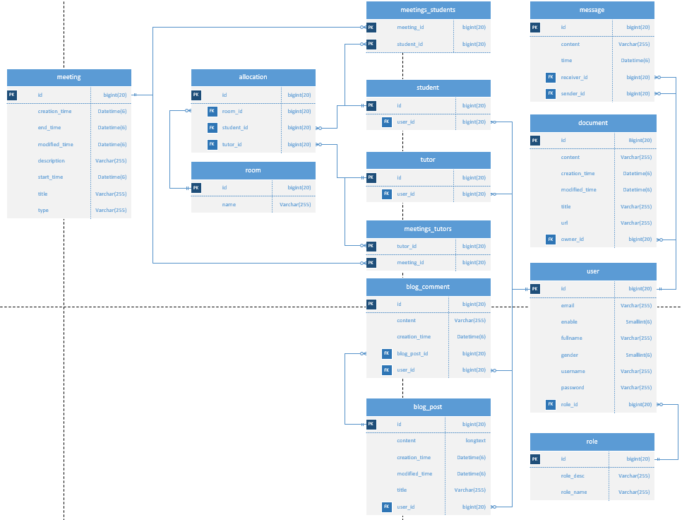
Database Structure Design
Contributed:
Mr. Vinh.
Mr. Thong.
Mr. Hieu.
Ms. Hue.
Mr. Phong.
Mr. Trung.

Slide 10
Development to MySQL
Coding and developing will base on the design from previous step.
MySQL being choose because it is free and has General Public License, can be used freely for the student project.

Slide 11
Interface

Slide 12
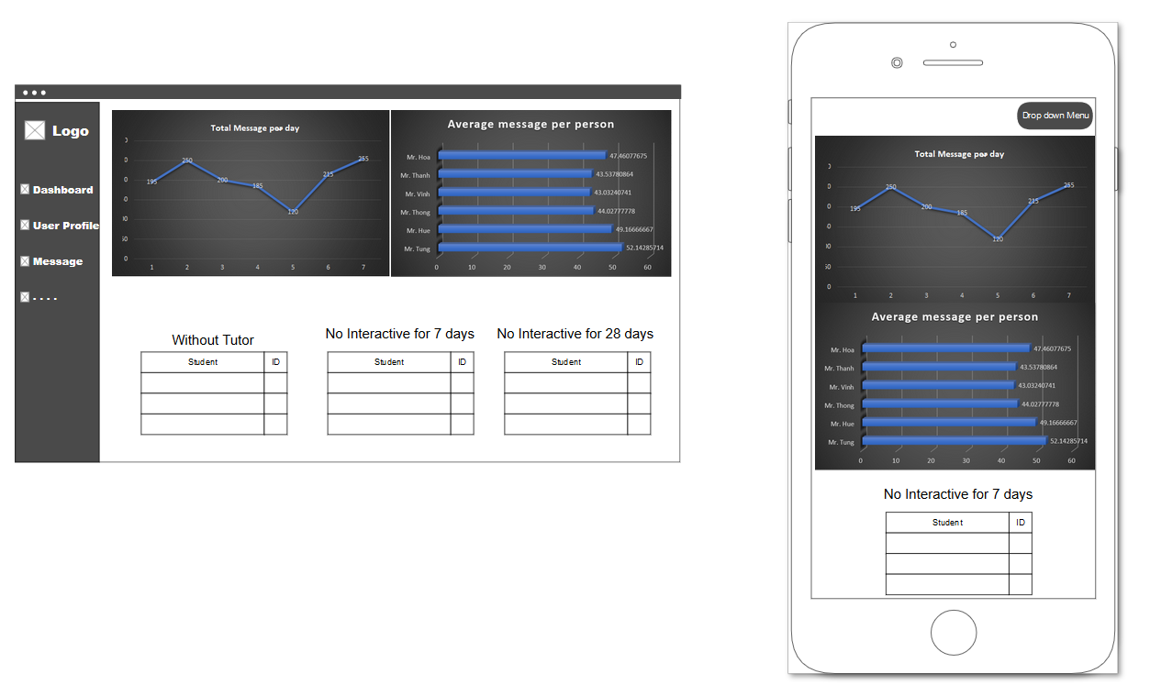
Interface Design
Mockup will be created first to wrap up the contents of the interface
May be slightly different compare to the real website
Some functions may be presented on the surface, some are not (ex: role authorize)

Slide 13
Frontend

Slide 14
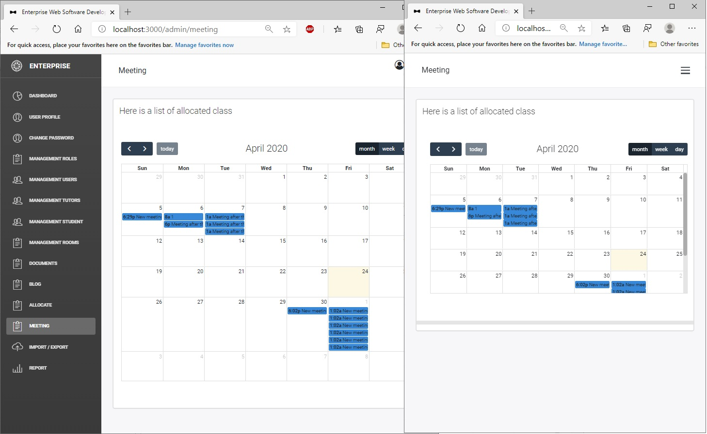
Using Bootstrap to develop
Quick template for a website.
Responsive website being built with easy.
Flexible.
Affordable. (free to use license for education purpose – good for students)

Slide 15
backend

Slide 16
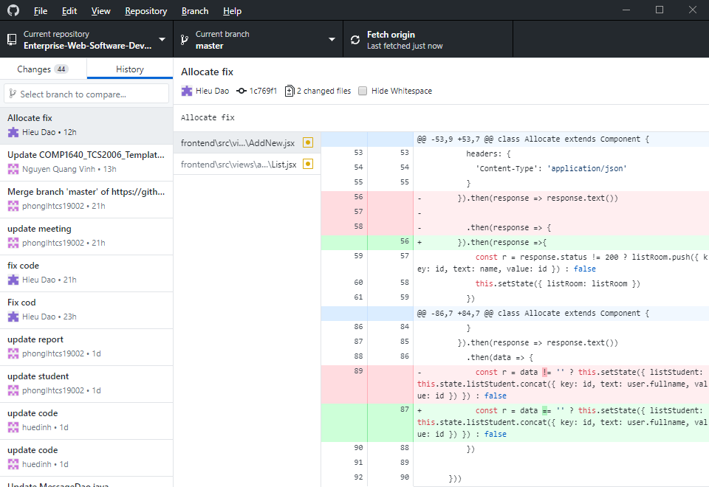
Function development
Using Eclipse as integrated development environment.
Github as the version control, save code and also documents
Each member will carry from one to many functions depend on the work load

Slide 17
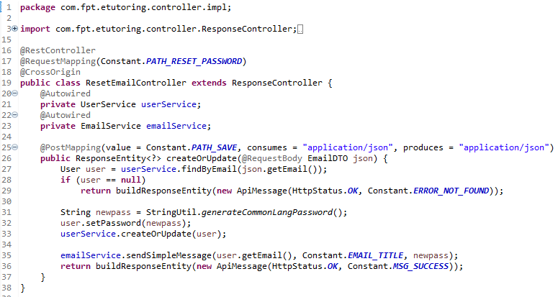
Sample code
- Sample java code from reset email controller

Slide 18
faq

Slide 19
demo

Slide 20
END
Thank you for taking your time

